Slide 1
Reviewing the dementia pathway in Wakefield Service Review July-October 2022
Report for commissioner

Slide 2
Executive Summary
We were asked to obtain a baseline view of current service provision from people with dementia, their carers, and professionals living and working in Wakefield and the Five Towns. This included: Identifying how a diagnosis was reached and whether there were any barriers experienced, determining how services are accessed and whether linkages between existing providers need to be improved to help signpost people to the most appropriate service for their needs, and mapping support that was available for service users.
We delivered this through four stages of engagement/evidence collection activity (see slide 4). We have generated insights around four thematic areas that correspond to 8 service recommendations (see slides 15-18).
Our insights show that people in Wakefield want a clearer process and named point of contact to follow throughout the dementia journey. They told us peer support in groups is very important to them and acknowledged there are a lot of great organisations and services available. However, many people are unaware of them, some are dependent on location and many people cannot access these services due to transport issues. There was support for the standardised implementation of the annual review, and better at home services for people living with dementia. Further recommendations show that a review should be conducted on social care capacity and access. This should include the acceptance criteria for care homes, how care packages are maintained during a hospital admission, and access to respite and domiciliary care.
"Sometimes I feel invisible"
"I don’t want to be a burden,
but I just want
someone to talk to"

Slide 3
Methods

Slide 4
Methods Overview
Step one: mapping the pathway
At Alzheimer's Society we strive to produce work built both on the robust use of evidence and co-produced with those affected by dementia. Throughout this project we co-produced both our recommendations and our methodology. We endeavoured to include a diverse range of local voices when developing our understanding of dementia services in Wakefield and the Five Towns. Our engagement approach was comprised of four stages of activity:
We, first, mapped the dementia pathway including the services available and the data that assessed these services.
We, secondly, captured a broad but thorough understanding of the experiences of those working in and using dementia services in W&5T. We did this by using surveys, focus groups and hosting roadshows.
Informed by this analysis, we generated a targeted understanding of the experiences of those infrequently heard or excluded from traditional methods. We did this by using Talking Mats and 1:1 interviews.
Finally, we consolidated the insights to build workshop resources that were used to empower people affected by dementia and local stakeholders to co-produce service recommendations.
Step two: capturing a broad view
Step three: generating a targeted view
Step four: consolidating learning & building
recommendations

Slide 5
Methods Our Reach
1119 people contributed to the project
831 participated in one of our roadshows
55 attended our recommendation building workshop
233 participated in a survey, interview or focus group
Comprised of*
114 professionals
89 people affected by dementia
10 Alzheimer's Society Staff
75 members of the public
* Breakdown does not include those who attended the roadshow
"We would gain so much if we were given the time to talk about what we want and how we feel, that is very important"
Notes:
* Breakdown does not include those who attended the roadshow

Slide 6
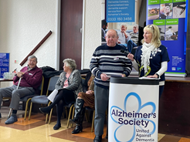
Methods Different Voices
Involving Local People Living with Dementia
Members of the local Dementia Voice group, Our Dementia Voices, were influential from start to finish. Many of them spoke at the dementia roadshows, took part in question formulation, and attended the recommendation workshop.
Involving Professionals
Local professionals were involved in numerous ways. As well as taking part in surveys and focus groups, many professionals supported the project in other ways:
Distributing the survey links via their networks.
Completing Short Interactions with people who used their services.
Following completion of the survey a number of professionals were interviewed further to deepen our understanding of the pathway.
Focus groups were vital in helping to guide the process and increase the depth of engagement.
The Poplars (inpatient mental health centre) invited us to observe their work and interview the staff on shift.
Across three roadshows in the district, 59 Local professionals were involved with this engagement piece in numerous ways. As well as taking part in surveys and focus groups, many professionals supported the project in other ways:
Notes:
* Breakdown does not include those who attended the roadshow

Slide 7
Dementia Pathway

Slide 8
Dementia Pathway Summary
To capture a detailed understanding of the challenges within the dementia pathway in Wakefield and the Three Towns, a broad range of data sources were used and analysed. Collectively these tell a story about the services on offer across the Dementia Pathway in Wakefield, the data behind these services, and the experiences of those at the heart of these services.
The following three slides summarise these three levels of evidence in turn.
"It's like you're dying before your dead. When they just don’t
acknowledge you"
Notes:
PCN = Primary care Network

Slide 9
Dementia Pathway The Services
Pre-diagnosis
AS* staff
AS Dementia Connect
GP
Care coordinators
Rapid access team
Age UKWD
Live Well Wakefield -social subscribers
Nova
Diagnosis
AS local staff
AS Dementia
Connect
GP
Care coordinators
Hospital Services
Memory Clinic
Carers Wakefield
Post-Diagnosis
AS local staff
AS dementia connect
Age UKWD
Memory Action Group
Singing for the Brain
Bless
Normanton Wellbeing
Charity
Coal Regeneration
CISCWO @Thorney Croft
Admiral Nurses
Car Coordinators
Solicitors
Well Woman Centre
Healthwatch Wakefield
Access Bus
Social Services
Mental Health Practitioners
Turning Point
Live Well Wakefield
My Therapy
Wakefield District Housing
Mental Health Navigator
Wakefield Fire and Rescue
Supporting well
Alzheimer's Society
Admiral Nurses
Age UKWD - discharge from hospital services
Live Well Wakefield
Samaritans
Community Volunteer Teams
Day Centres - Active Mind, St Catherine's, New Hope, Thornyfield Day Centre, Hospice
My Therapy – Physio
Social Workers
Private care agencies Wakefield District Nurses
Incontinence Team
﻿﻿Care link Rapid response team
Carehomes Mental Health Practitioners
Hospital complex need team
Safe Space team
Living well for Carers
﻿﻿New horizons
﻿﻿Turning point
﻿﻿Alzheimer's Society for emotional support
﻿﻿Carers Wakefield
Admiral Nurses
Hospice
Living well
Pride Wakefield
MESMAC
﻿﻿BAME Ladies Care Group
﻿﻿Carers Wakefield specific groups
Dying well
Admiral nurses
Family
GP
﻿﻿District nurse
Health Care assistants
﻿﻿Private carers
Alzheimer's Society for emotional support
﻿﻿Social care
﻿﻿St Gemma’s
Hospice
* Alzheimer's Society
Notes:
PCN = Primary care Network

Slide 10
Dementia Pathway The Numbers
Pre-diagnosis
Wakefield scores higher in relation to risk factors linked to dementia in comparison to England average:
- IMD (+5.6)
- Smoking (+3.1)
- Hypertension (+1.5)
Obesity (+1.6)
Diagnosis
Wakefield's diagnosis rate stands at 62.1%, a drop of four percentage points from pre-Covid (66.1%, March 2020).
Wakefield needs to diagnose an additional 184 to reach the national target of 66.7%.
Supporting well
Pre-Covid (March 2019), good proportion of annual dementia reviews – between 71.9% and 78.6%.
March 2022, Wakefield's PCN* average is 44.3% and England's is 48%.
Living well
In Care homes
CQC-reported care home quality in Wakefield finds that 58% of care homes (28) are rated as good, compared to 80% in England, a 22%pt difference. Similarly, 35% of care homes in Wakefield (17) require improvement in comparison to 14% in England.
Living well
In Hospitals
Pinderfields hospital scores significantly lower than England average in experiences of patient care, hospital communication and discharge planning/processes.
Living well
For Carers
Carer-reported quality of life score for people caring for someone with dementia in 2018/19 is third lowest (7.1) in all of YatH (7.5) but scores just under 7.3 for England.
Notes:
PCN = Primary care Network

Slide 11
Dementia Pathway The Experiences
Pre-diagnosis
Only 55% of the public knew where to go for help if they were concerned about dementia symptoms.
"If the person doesn't have a diagnosis, they can't access and unlock the key services they need. There doesn't seem to be any emotional support for people who are awaiting a diagnosis" – Professional
"Patients are waiting a long time to get an appointment" – Professional
Diagnosis
17 of 30 professionals felt that the diagnosis process needs changing.
4 of 6 carers thought that the time taken to get the dementia diagnosis was acceptable.
"I was told [my diagnosis] over the phone and when I got upset the doctor said, 'well I don’t know why you are crying you and your friends knew what you had’” - Person living with dementia
Supporting well
11 of 17 professionals reported not knowing enough about other organisations across Wakefield.
5 of 8 carers felt that the professional they first spoke to understood their concerns.
"It seems as though professionals are not talking to one another. It boils down to the carers to chase people up" – Carer
Living well
7 of 12 carers were not given information and/or support to record future care wishes.
"What’s working well is initial set up for a lot of people, not all. There’s that middle period isn’t there because they get support in crisis too, but it’s the living [day to day]. They need help then. They need a clearer team and pathway" - Professional
Living well
With Care
"Due to staffing shortages, we are no longer accepting respite support, and we no longer have the physical spaces as well. If we had better financial support from the Council, we could think about further development" – Professional
"Losing care packages while you’re in (hospital) that then leads to lengthy stays" - Professional
Living well
For Carers
6 of 8 carers did not receive any support or information.
"I became so ill, he had to go into respite. It has affected my health, there is a lack of support and none at night“ - Carer
“I would like a named person or agency that could help me through the myriad of options, so I know what is best for my father and me as a carer. We both have different needs” – Carer
Notes:
PCN = Primary care Network

Slide 12
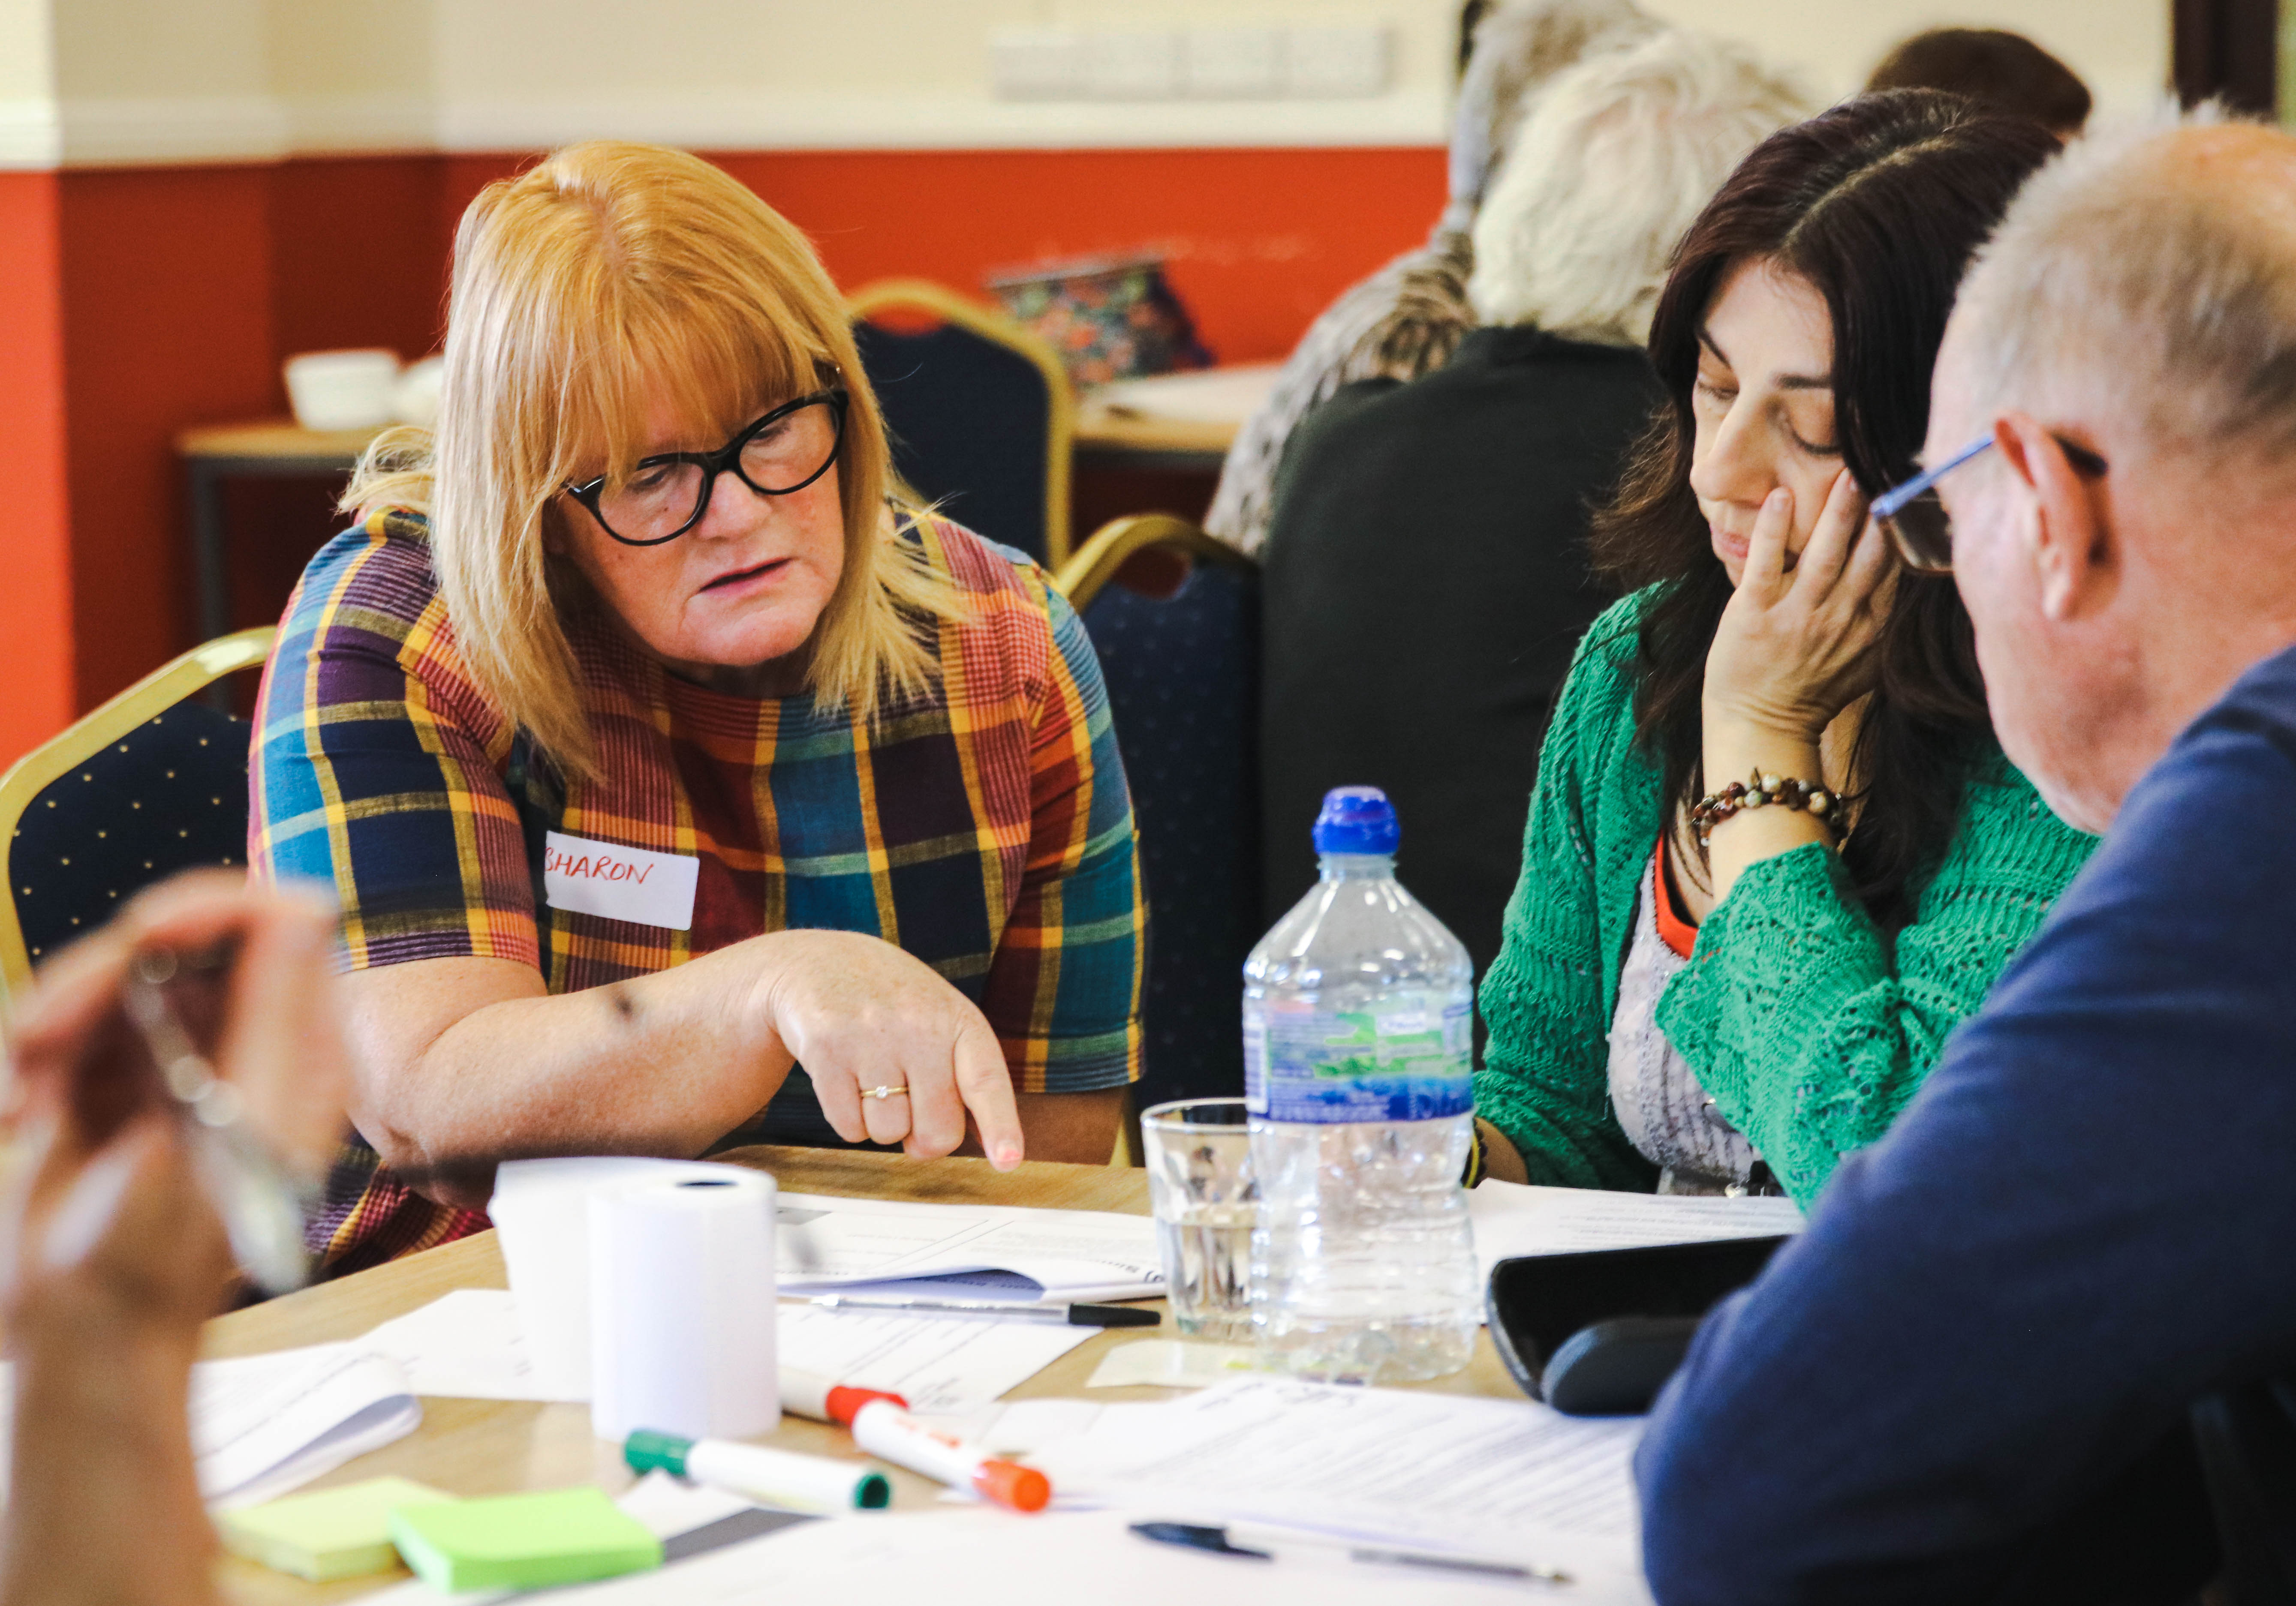
Dementia Pathway What is working well
To be able to provide suggestions for improvements to the dementia pathway this project has primarily focused on the challenges within this service. However, several positive themes also emerged from the engagement. These are listed as follows:
Group services increased socialisation
Good Peer support
A general sense of satisfaction with memory services
A strong will from professionals to work better together to achieve better outcomes for people affected by dementia.
A readiness to engage and understand the local pathway as evidenced by attendance of local providers at the roadshows

Slide 13
Recommendations

Slide 14
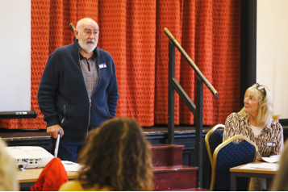
Recommendations Summary
This project aimed to generate recommendations for improvements to the dementia pathway in Wakefield and the Five Towns. These were built on deep local insights, co-produced by those affected by dementia and other key stakeholders, generated using innovative methods to inspire creativity and refined to ensure their feasibility.
The service recommendations are based on the insights generated and have been presented thematically. Each theme meets a specific request in the project bid. This section outlines each theme in turn, before connecting these recommendations to similar national service recommendations on slide 25.
The four insight themes are as follows:
Dementia Knowledge and a Timely Supported diagnosis
Access to a Pathway of Support
Collaborative Working
Transitions to Care, Hospitals and End of Life

Slide 15
Recommendations Theme One: Dementia Knowledge & a Timely Supported Diagnosis
1. We were asked to…
identify how a diagnosis was reached and whether there were any barriers.
4. We recommend …
To improve access and experience of annual dementia reviews, primary care networks should work towards returning reviews to pre-Covid levels. These should be conducted through a multidisciplinary team approach, ensuring that people can benefit from a range of specialisms within primary care. Carer health and wellbeing should be a vital part of each review.
Wakefield should work towards returning the dementia diagnosis rate to the national target (66.7%) and people should wait no longer than 18 weeks for a diagnosis after referral to a specialist.
Engagement with the public around dementia should be routinely conducted through local roadshows, campaigns, and dementia specific training to increase awareness and understanding of the condition. The information available should cover different aspects of the dementia pathway from prevention to dying well.
2. We heard …
All attendees affected by dementia at the focus groups reported delays in receiving a diagnosis with three carers reporting a misdiagnosis at first. When asked in the snapshot survey would you change anything to improve the diagnosis experience? 50% of respondents said yes. 10 out of 34 respondents who left a comment wrote about lengthy waiting times, making the process easier and quicker, and the need for more compassionate delivery with clearer practical advice on what to do next.
3. We found …
Two key challenges, the first around a lack of knowledge of dementia symptoms and where to get help. This caused a hesitancy to seek support. The second challenge was in the diagnosis process. This was described as slow. At times the individuals affected needed to chase health and social care professionals to receive the support that they needed.

Slide 16
Recommendations Theme Two: Access to a Pathway of Support
1. We were asked to …
Identify what is in already in place and the unmet needs of people with dementia and their carers and to determine how services are accessed.
3. We found …
There were two key challenges identified around the access to support services. Firstly, people wanted a clearer understanding of what services were available and a clear pathway supported by a single point of contact to direct them to the help they needed. Secondly, for particular groups such as those living alone or those with difficulty accessing public transportation, additional support was needed to ensure equal access to services.
2. We heard …
We worked with local professionals to map the dementia pathway*. Whilst there are many services listed under ‘Supporting Well’ this was not always reflected in peoples’ experiences, some reported finding services by chance.
During the mapping workshops one professional commented that there are key challenges for “people who live on their own, if they have personal care needs, they can’t go to most groups...if they could get transport... they don’t always remember to get ready...so they are excluded”. This was an issue that was repeatedly mentioned throughout the engagement period.
4. We recommend …
Once discharged back to primary care, every person diagnosed with dementia should be allocated a single point of contact, with the details on how to contact them. Increased availability of Dementia Advisors working alongside primary care professionals to provide specialist advice would be beneficial. Data should be collected locally to understand access issues.
Transport should be available and accessible for people affected by dementia. Access barriers include poor service in rural areas, a need for transport reminders and support preparing people to leave their homes.
Notes:
This can be found on slide X

Slide 17
Recommendations Theme Three: Collaborative Working
We were asked to…
Find out whether linkages between existing providers need to be improved to help signpost people to the most appropriate service for their needs.
3. We found …
Key challenges in the current service provision existed because professionals were not always aware of available services across different areas across the region.
2. We heard …
One professional in a focus group acknowledged that...“you get to know a service, so due to time constraints and knowledge gaps you just always refer there and it may not be the most appropriate.”
During these discussions another professional highlighted that there were inequalities across the district “you think something is out there for everyone but it's not, it depends where you live.” Professionals were keen to work together to avoid duplication, improve services and provide holistic support for those with complex needs.
4. We recommend …
The idea of having a multi-disciplinary meeting at community level and not just clinical level was well received in the focus groups and subsequent meetings.
Quarterly peer learning sessions should be established for all services involved in dementia care. This can build and strengthen partnerships, and increase the clarity of services, as well as the roles and responsibilities across the dementia pathway. Building on from the dementia pathway map developed in this project, this can support the development of a directory of local information, services and referral forms for professionals.

Slide 18
Recommendations Theme Four: Transitions to Care, Hospitals and End of Life
1. We were asked to…
Gather experiences of care homes and end of life care. During the project field work stage, we were also asked to look at people's experiences in hospitals and delays to discharge.
3. We found …
Key challenges in the provision of residential and domiciliary care services. Care homes were struggling to accommodate people with dementia or higher needs which was placing additional pressure on carers and hospitals.
2. We heard …
Carers told us how they felt confused by the system and several told us how their loved one had to move on as the home could not support them when behaviour changed. There is a lot of work being done by the hospital to support people affected by dementia but there are long delays to discharging people due to loss of care packages or no suitable support at home.
4. We recommend …
A review should be conducted on social care capacity and access. This should include acceptance criteria of care homes, how care packages are maintained during a hospital admission, and access to respite and domiciliary care.
Everyone diagnosed with dementia should have access to a dementia support worker or similar service. To improve uptake, they should be delivered in each primary care network, with an automatic referral from memory services.

Slide 19
Recommendations All Recommendations
Once discharged back to primary care, every person diagnosed with dementia should be allocated a single point of contact, with the details on how to contact them. Increased availability of Dementia Advisors working alongside primary care professionals to provide specialist advice would be beneficial. Data should be collected locally to understand access issues.
To improve access and experience of annual dementia reviews, primary care networks should work towards returning reviews to pre-Covid levels. These should be conducted through a multidisciplinary team approach, ensuring that people can benefit from a range of specialisms within primary care. Carer health and wellbeing should be a vital part of each review.
Wakefield should work towards returning the dementia diagnosis rate to the national target (66.7%) and people should wait no longer than 18 weeks for a diagnosis after referral to a specialist.
Transport should be available and accessible for people affected by dementia. Access barriers include poor service in rural areas, a need for transport reminders and support preparing people to leave their homes.
Engagement with the public around dementia should be routinely conducted through local roadshows, campaigns, and dementia specific training to increase awareness and understanding of the condition. The information available should cover different aspects of the dementia pathway from prevention to dying well.
Quarterly peer learning sessions should be established for all services involved in dementia care. This can build and strengthen partnerships, and increase the clarity of services, as well as the roles and responsibilities across the dementia pathway. Building on from the dementia pathway map developed in this project, this can support the development of a directory of local information, services and referral forms for professionals.
A review should be conducted on social care capacity and access. This should include acceptance criteria of care homes, how care packages are maintained during a hospital admission, and access to respite and domiciliary care.
Everyone diagnosed with dementia should have access to a dementia support worker or similar service. To improve uptake, they should be delivered in each primary care network, with an automatic referral from memory services.

Slide 20
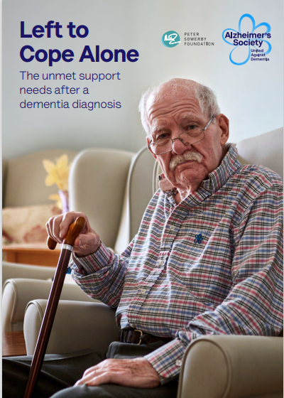
Recommendations Linking National and Local Recommendations
The project focus was to understanding the needs of those local to W&3T and therefore the recommendations are custom-made for this community. However, this slide identifies several national recommendations that support those identified locally.
Local health systems should support primary care to return care plan reviews to pre-pandemic levels, such as 75% in England, by April 2023*.
Local health systems should undertake a multidisciplinary team approach to annual reviews and stagger reviews throughout the year to improve quality and increase primary care capacity*.
Ensure everyone diagnosed with dementia has access to a dementia support worker or similar service. These roles should be featured as the first point of contact in every primary care network, with automatic referral from memory services. To reduce crises, the service should be delivered as part of an overall, integrated ‘stepped’ model of care where people can easily access more specialist intervention within the community as their needs become more complex. These roles should include a community link worker component in areas with a high ethnic minority population*.
Department of Health and Social Care should work with NHS England and NHS Improvement to produce clear guidance on care coordination. This should include who can do it, what it involves and transition requirements if the care coordinator changes along the pathway. This should be supported by regular data collection and publication+.
*Left to Cope Alone: The unmet support needs after dementia diagnosis. (Alzheimer’s Society, 2022)
+Diagnosis to end of life: The lived experiences of dementia care and support (Alzheimer’s Society, 2020)

Slide 21
Conclusion

Slide 22
Conclusion Summary
This project aimed to increase the understanding of the dementia pathway in Wakefield and the Five Towns. Using co-production approaches, the findings and recommendations in this report have been produced by local people for local people. Whilst many positives about services in the area emerged from this process, we were made aware of changes that needed to be put in place to support all affected by dementia.
Despite some positive accounts of memory services, some respondents report lengthy waits for diagnosis and a lack of compassion and understanding from GPs.
Many report happening upon support by chance and the vital role that local groups play in connecting them to wider service provision.
A clearer, more systematic pathway is needed. People want to access this through a single named contact. There is confusion over who to contact six months or a year down the line when things change, and some people feel forgotten and abandoned.
There is a strong will to work better together to achieve better outcomes for people affected by dementia, and there are many great services. More needs to be done to connect these by creating space and time for professionals to collaborate.
People are losing their care packages whilst in hospital and staff shortages in the domiciliary care sector have led to longer unnecessary stays in hospital. These are distressing for the person and family, make things more difficult for staff, and are more expensive for local service providers.
Wakefield is behind the national target for dementia diagnosis rates and has a higher-than-average prevalence of many risk factors for dementia. Wakefield is below average for its annual dementia review completions, and quality of life scores for carers.
These findings are epitomised in the four report insight themes (dementia knowledge and a timely supported diagnosis, access to support, collaborative working, and transitions to care) and tackled in the 8 report recommendations presented on slide 17.

Slide 23
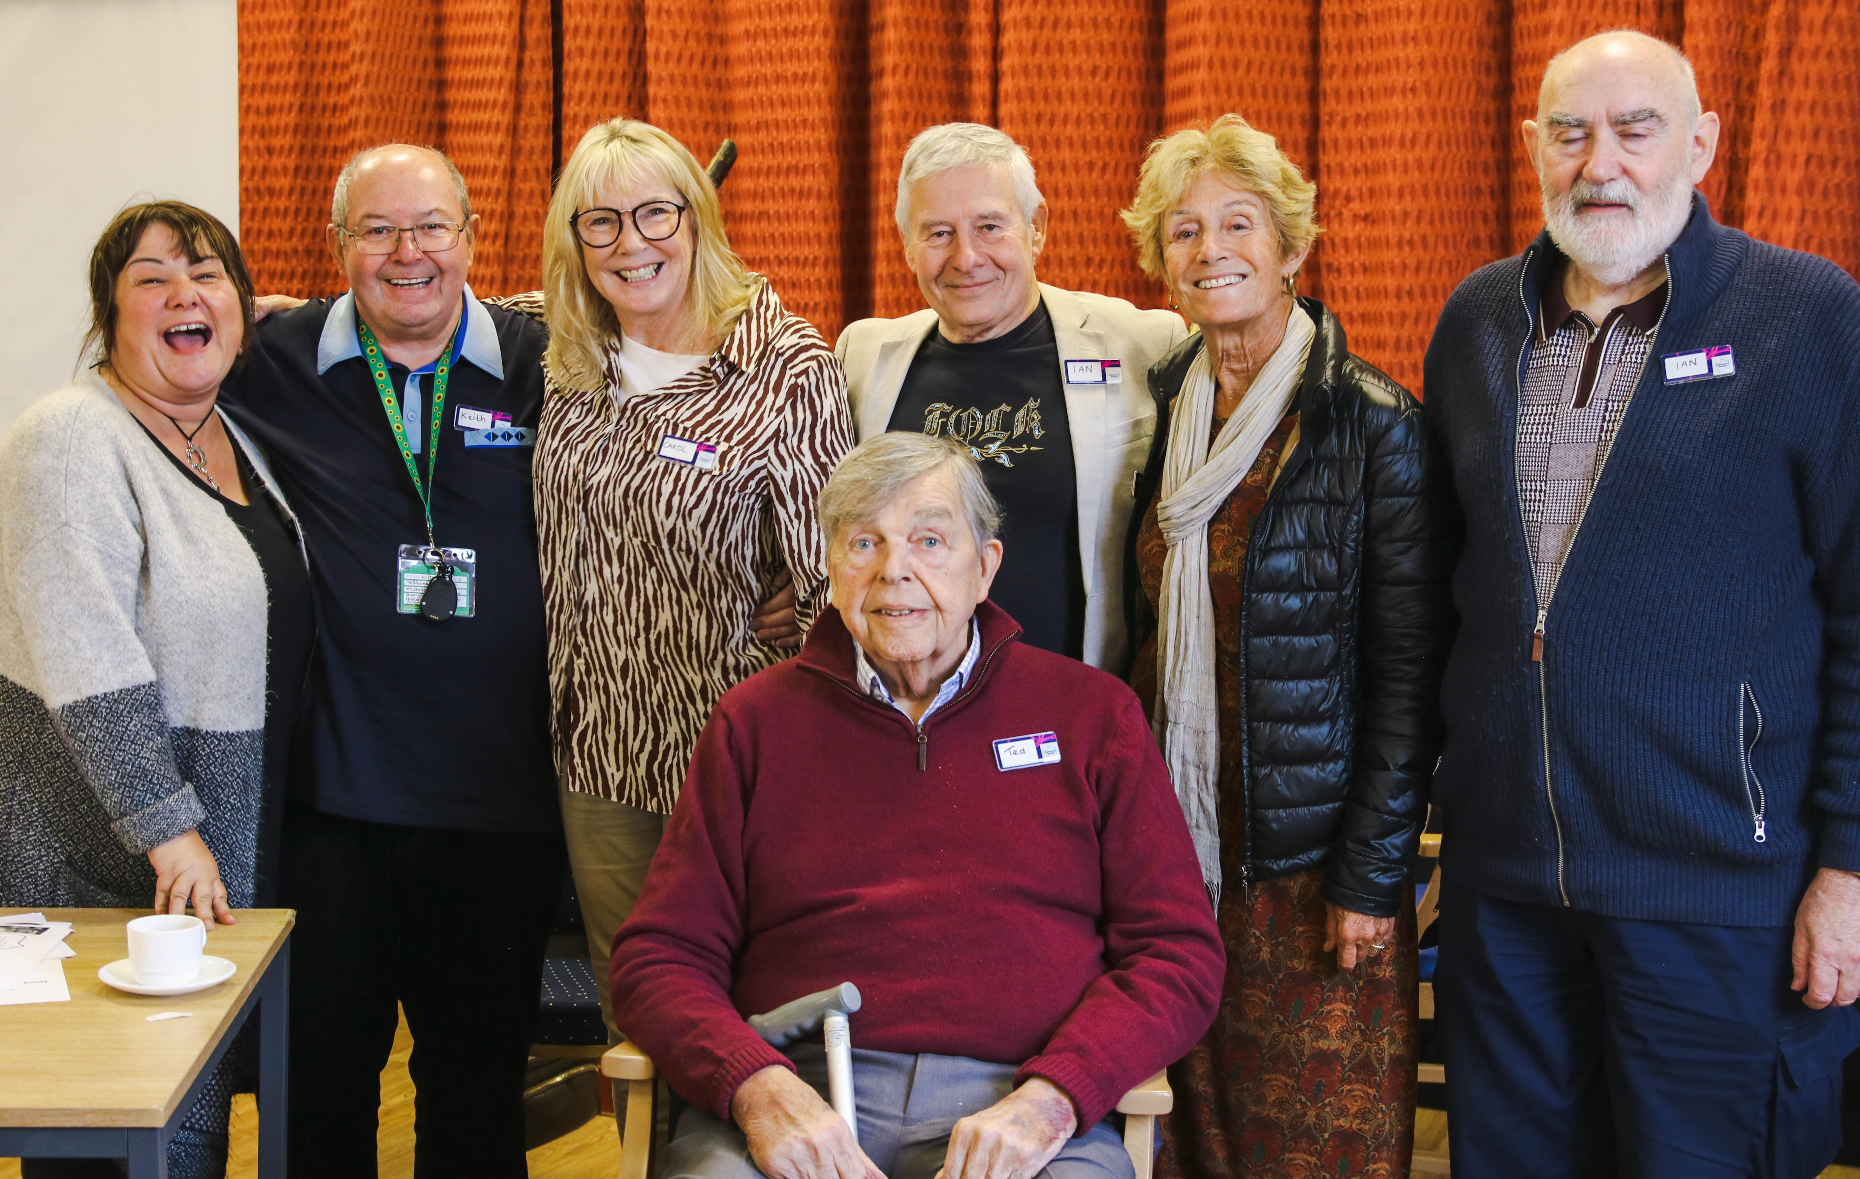
Conclusion Next Steps
Continued Exploration of Insights​
We would now like to invite local commissioners to have further conversations with Alzheimer's Society to gain a deeper understanding of this report and to begin discussions around how these recommendations might be realised. We encourage commissioners to think of the engagement in this report as the first step in this work, and for further engagement with a broader reach to be a central part of inward project activities.
Call to Action Event
We will be holding a celebration and call to action event before the end of the year during which we will distribute, with the consent of commissioners, the summary two-page report to local people who took part in the engagement. There is a reserved place for your comment in this document. We will also hand over the pathway diagram with additional sheets with contact numbers and referral criteria. We would recommend that led by commissioners there is a further event in March/April to reconvene and share any actions taken, plans, and lasting impact from the report.
Collaborate on the Delivery of Service Recommendations
To ensure there is real positive change on the back of this report it is imperative that all local organisations hold a strong sense of shared ownership over these service improvements. The professionals we engaged with are willing to play their part, and on the back of this project, discussions have already begun around the delivery of MDTs.

Slide 24
Thank you
A diverse project team representing the breadth of experience across Alzheimer's Society delivered this project. Including: Dementia Voice, Evaluation and Impact, Innovation, and Wakefield Local Services.
The following organisations have supported the creation of this report: NHS Mid Yorkshire Hospitals Trust, NHS Southwest Yorkshire Partnership, Carers Wakefield and District, trinity Medical Centre, Age UK Wakefield, Croft Care Group Partnership in Care, dementia UK, Wakefield Council, memory Action Group, CISWO, Live Well Wakefield, and Healthwatch Wakefield.

